Slide 1


JOSEPH BARKER
General Motors Company
US Market Analysis & Short-Term Forecasting

Slide 2
2012
Trends

Slide 3
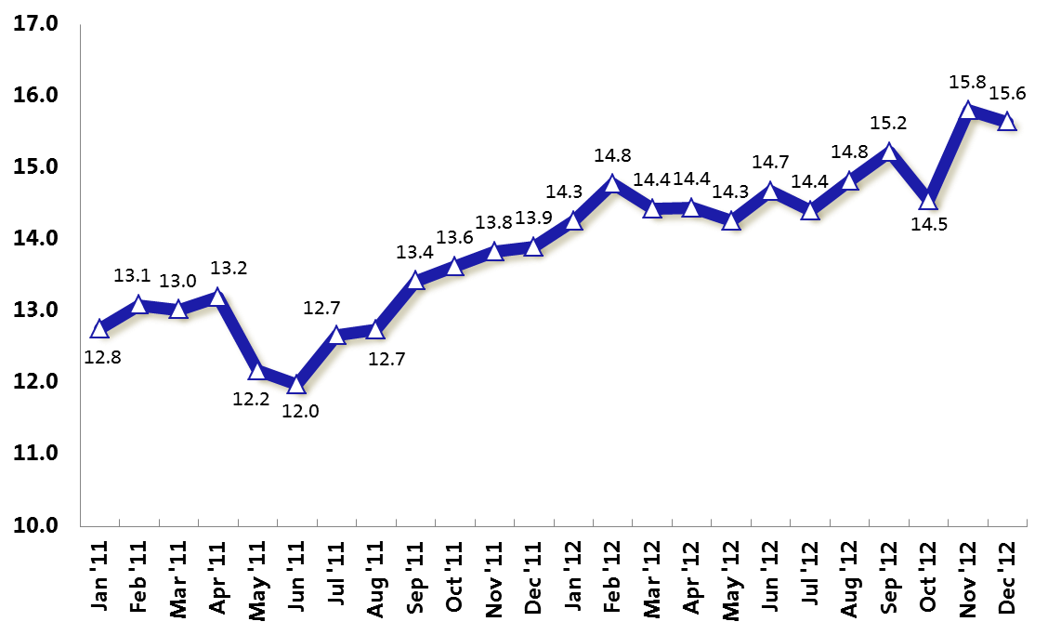
SAAR Progression
Product shortages stemming from Japan tsunami
Fast start to 2012 stemmed from pent-up fleet demand and Japanese OEMs pushing product in the final quarter of their fiscal year
Reached 15M for the first time since Mar 08 in Sep 12
Superstorm Sandy compromised the Oct SAAR by an estimated 300K units and lifted the Nov SAAR by an estimated 400K units
Strongest Q4 since 2007
Units in Millions
Influenced from Superstorm Sandy
Source: BEA

Slide 4
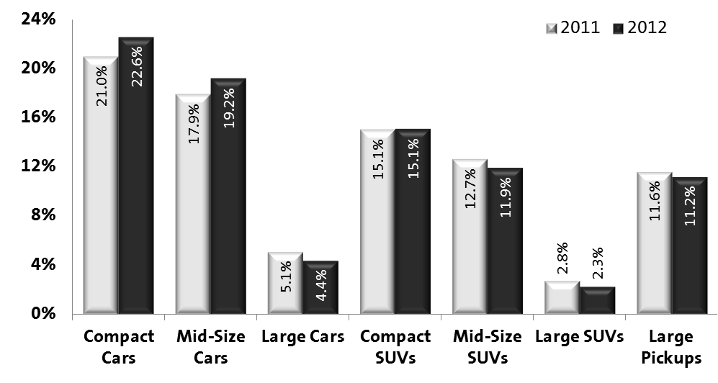
Market Share by Size Segments
Segment mix shaped by gas prices and new product introductions
Record demand for compact vehicles; 5.8M units represented 39% of industry sales in 2012
Non-luxury mid-size cars rose to its highest sales level since 1988; driven from the sell-down of outgoing models and replacements that were stylish, fuel-efficient, and rich in technology
Sales of luxury automobiles ended the year at a 5-year high, but retaining customers has been a challenge

Slide 5
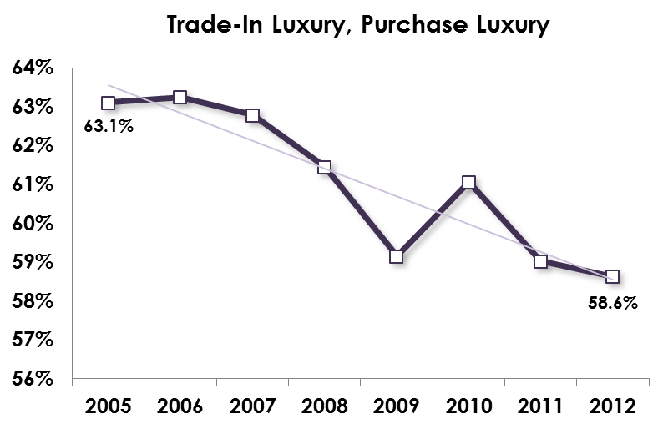
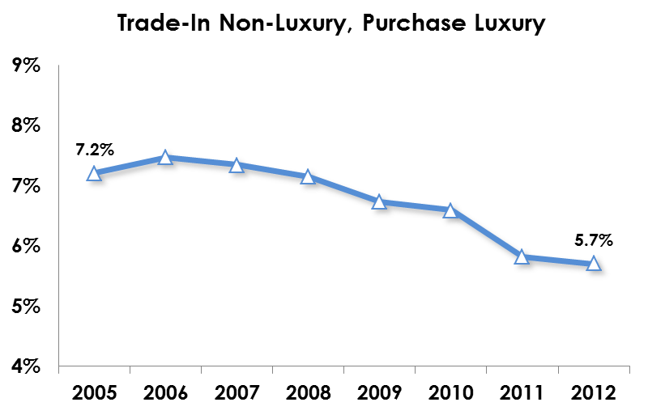
Luxury Loyalty
Source: PIN
Source: PIN
Smaller percentage of luxury owners are returning to the luxury market; defecting to stylish, sophisticated non-luxury vehicles that offer a strong value proposition
Smaller percentage of non-luxury owners are trading-up to luxury
Marginal customers are avoiding the luxury market, resulting in a higher mix of luxury purists

Slide 6
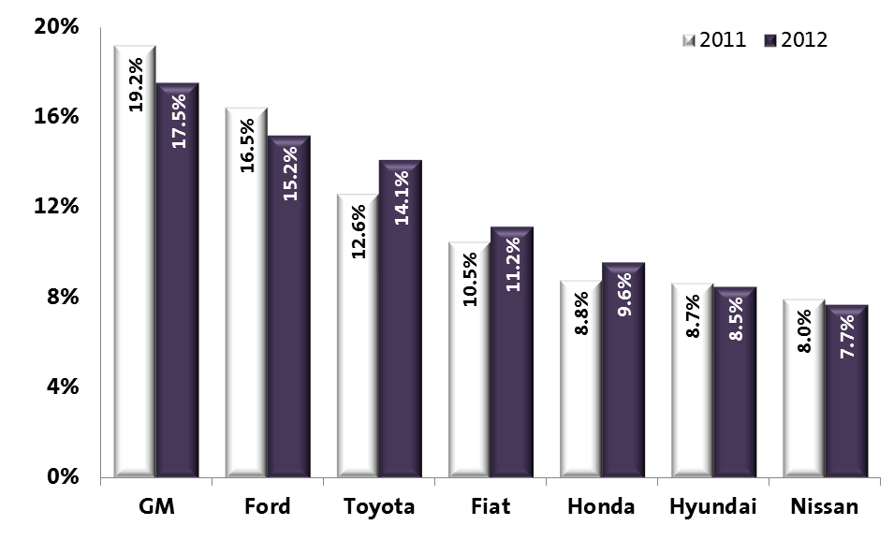
Market Share by Company
Toyota and Honda recovered market share, but share was well below pre-tsunami levels; conquest rate among the best, but was well below recent levels
Fiat (Chrysler) grew share largely from improved sales of mid-size cars and SUVs and the addition of Dart
Hyundai share decreased YOY for the first time since 1996; unable to sustain an artificially high conquest rate from a year earlier
Ford share slipped despite one of the industry’s youngest stable of products
GM share fell due largely to owning the industry’s oldest product portfolio

Slide 7
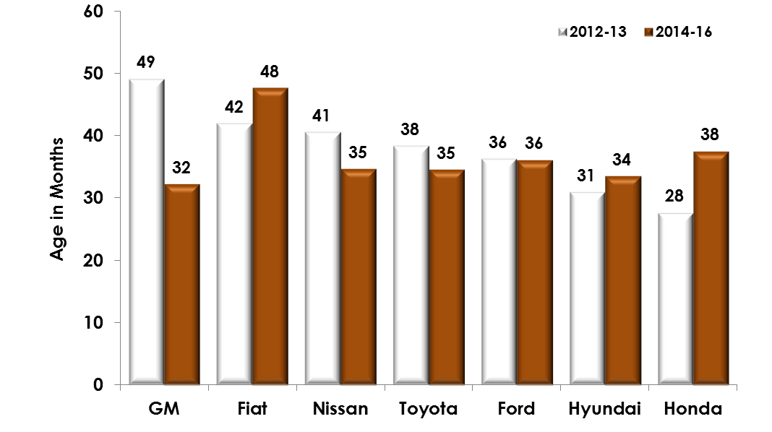
Average Portfolio Age
Source: PIN

Slide 8
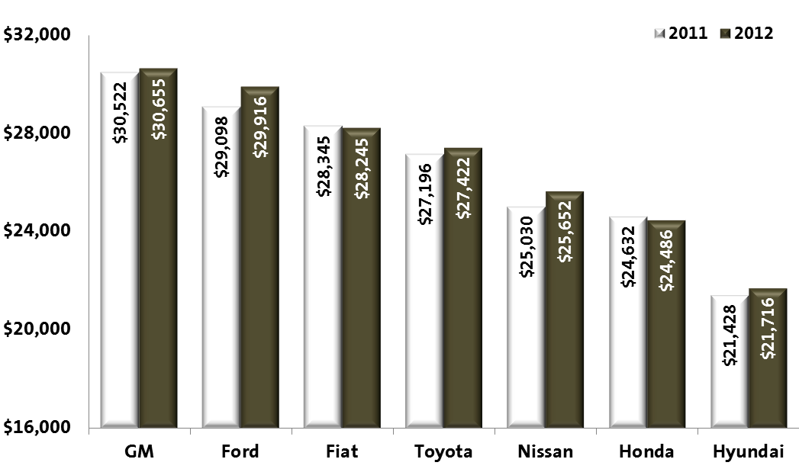
Average Transaction Price (ATP)
Retail ATP reached a record high of $28,600 in 2012; low interest rates and increased lease mix promoted a rich product mix
GM is the price leader amongst all major auto companies
Redesigned core products drove-up ATPs at Ford and Nissan
Honda pricing depreciated from dated Acura products, weak market acceptance of Civic, and sell-down of Accord
Honda and Fiat were the only mainstream OEMs to experience an ATP reduction in 2012
Hyundai ATP trails the industry average by $6,800; less than 20% of company volume returns an ATP above $25K
Source: PIN

Slide 9
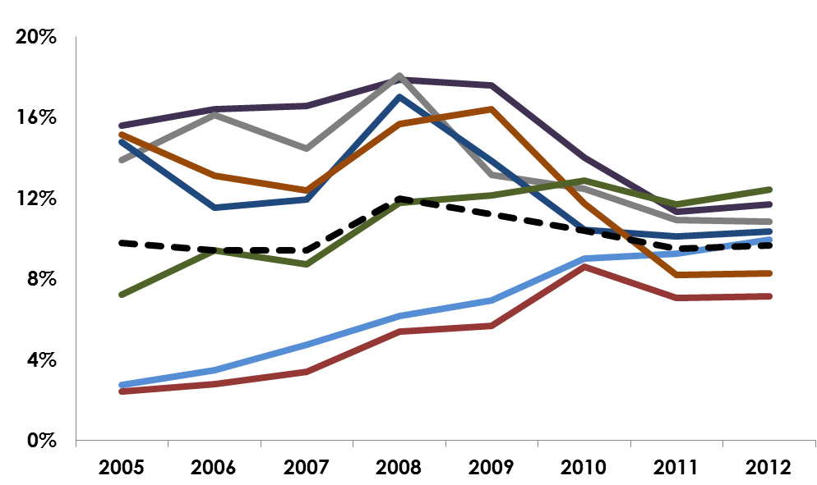
Average Incentive Spend as a % of ATP
Range between companies narrowed in recent years as GM, Ford, Fiat, and Hyundai slashed incentives and the Japanese boost discounts
Sell-down of high-volume vehicles lifted AIS as a % of ATP at Nissan to an industry high
Sell-down of Accord and Civic led to a company record high AIS as a % of ATP in 2012
With a mature stable of products, GM ranked slightly above industry average
Incentives reached record highs at Honda and Nissan in 2012
Nissan
Fiat
Ford
GM
Honda
Ind Avg
Hyundai
Toyota
Source: PIN

Slide 10
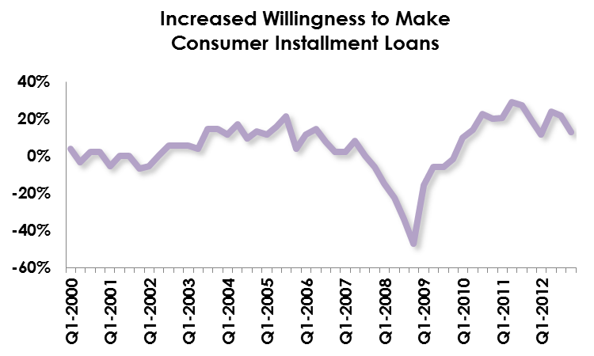
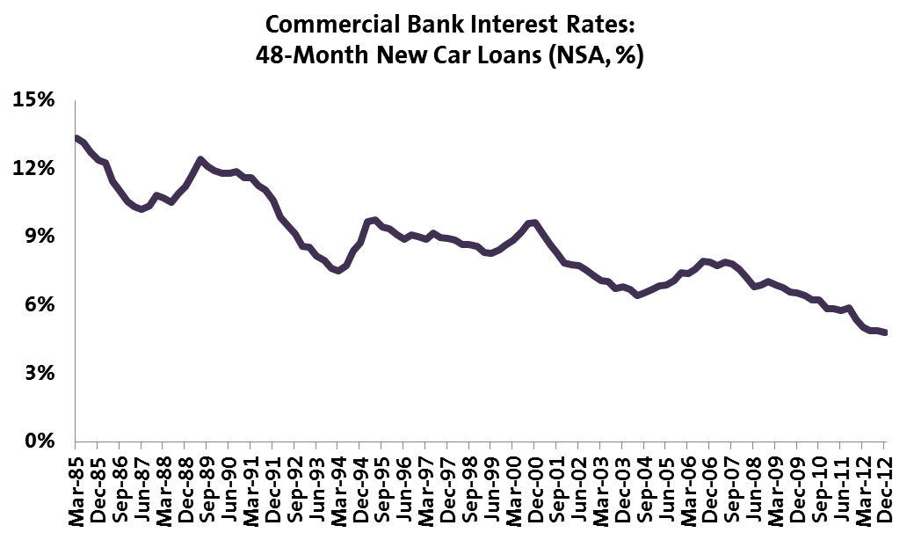
Credit Conditions
Source: Federal Reserve Board
Source: Federal Reserve Board/Haver Analytics
Quantitative easing is having a favorable impact on the auto sector
Auto interest rates dropped more than 2 ppts since the Fed lowered its target interest rate to zero in December 2008 and embarked on large-scale purchases of bank assets
Auto credit is available and affordable; interest rates on new automobiles are at record lows

Slide 11
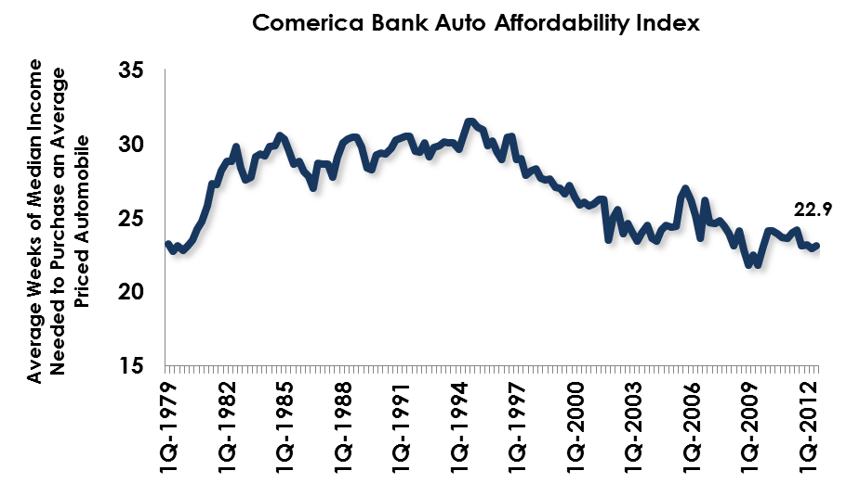
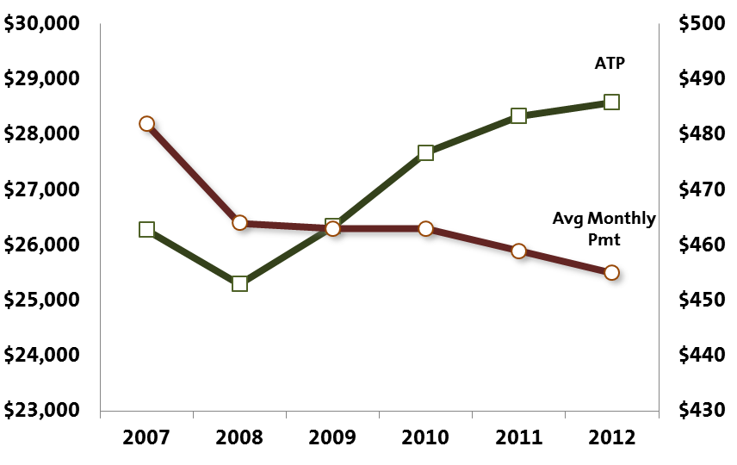
Auto Affordability
Source: Comerica Bank
Source: PIN
Comerica Bank Auto Affordability Index hovering around historic highs
While average transaction price rose at a healthy clip, average monthly payment declined
Record low auto interest rates, increased lease penetration, and extended finance terms have made autos affordable

Slide 12
Top Reason For Purchase
Experience with and image of model/brand, and fun to drive are less important; vehicle quality is less of a reason for purchase because it is less of an issue – the long-term reliability gap has closed
Fuel economy, styling, and ride comfort have grown in importance
Today’s customers are less loyal and more inclined to shop for practical and functional automobiles
Source: Maritz NVCS

Slide 13
2013 outlook

Slide 14
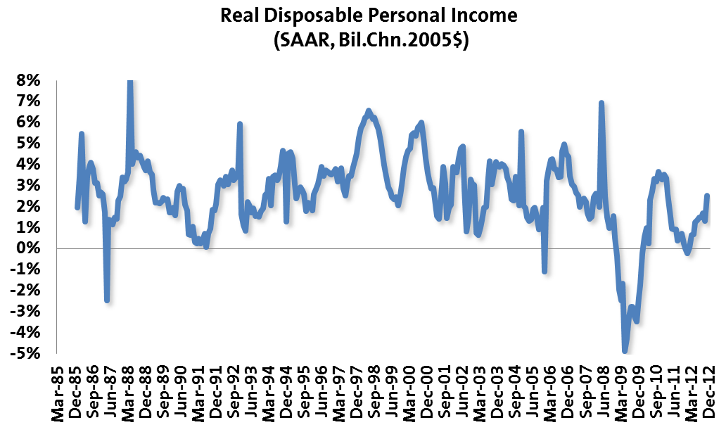
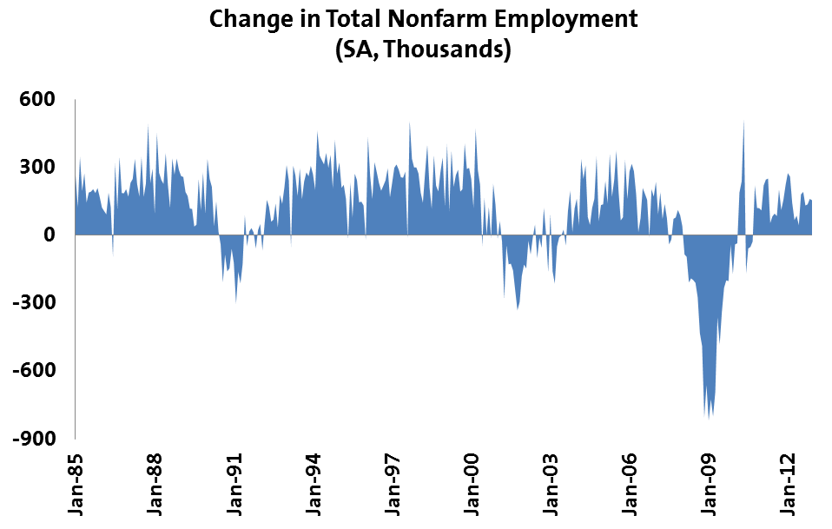
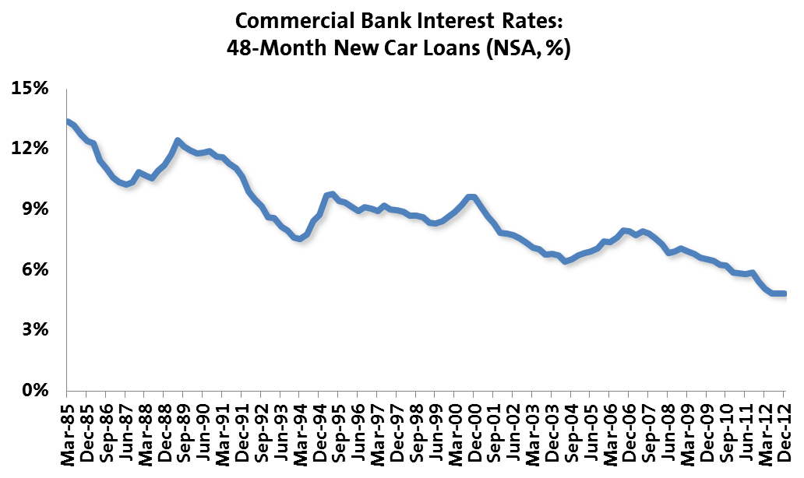
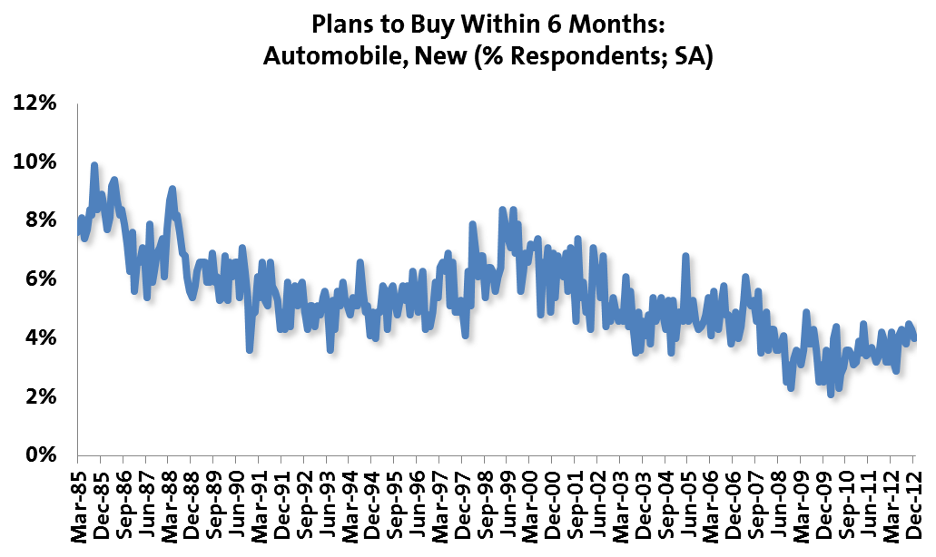
Vehicle Demand Fundamentals
Source: Bureau of Economic Analysis/Haver Analytics
Source: Bureau of Labor Statistics/Haver Analytics
Source: Federal Reserve Board/Haver Analytics
Source: The Conference Board/Haver Analytics

Slide 15
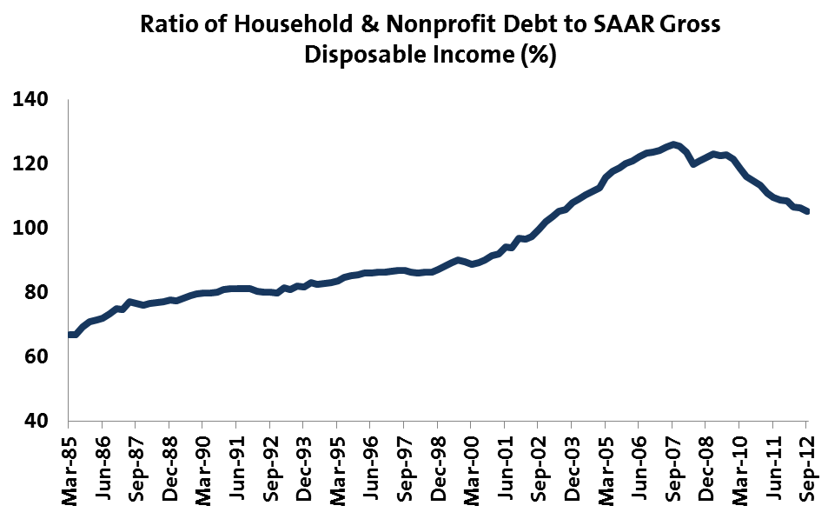
Household Debt
Source: Federal Reserve Board/Haver Analytics
Households continue to deleverage and repair balance sheets
Household debt levels are declining, but have further to go

Slide 16
Fiscal Policy
American Taxpayer Relief Act 2012
Tax rates increased from 35% to 39.6% (Clinton-era level) for couples with income > $450K and individuals > $400K; income below the threshold are taxed at Bush-era rates.
Tax on capital gains and dividends increased from 15% to 20% for couples with income > $450K and individuals > $400K; income below the threshold remain unchanged at 15%
Estate tax of 40% on estates above $5M (indexed to inflation) for couples with income >$450K and individuals > $400K
Payroll tax cut of 2% expired
Phase-out of certain tax deductions and credits for couples with income > $300K and individuals > $250K
The 2009 expansion of tax breaks for low-income Americans: the Earned Income Tax Credit, the Child Tax Credit, and the American Opportunity Tax Credit are extended for five years
The Alternative Minimum Tax is patched to avoid raising taxes on the middle-class
The full package of temporary business tax breaks will be extended for another year
Scheduled cuts to doctors’ fees under Medicare is avoided for a year
Federal unemployment insurance will be extended for another year, benefiting those unemployed for longer than 26 weeks
A nine-month farm bill fix
Though the tax piece of the fiscal cliff is resolved, uncertainty still exists over the debt ceiling and spending cuts

Slide 17
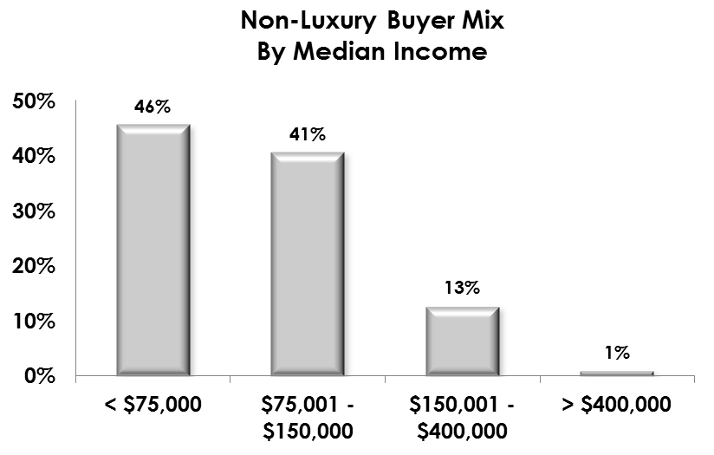
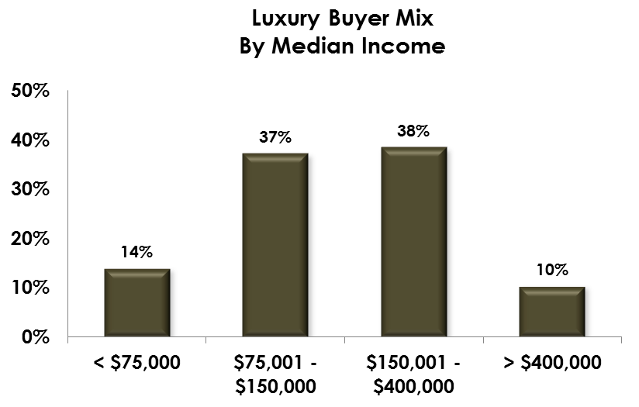
Sales Mix by Income
Source: Maritz NVCS
Source: Maritz NVCS
Just 1% of non-luxury buyers and 10% of luxury buyers earn more than $400,000 annually
The outcome of spending cuts and debt ceiling debates could have more of an impact on the lower to middle income families than did the American Taxpayer Relief Act 2012
Retired buyers make up 29% of industry sales

Slide 18
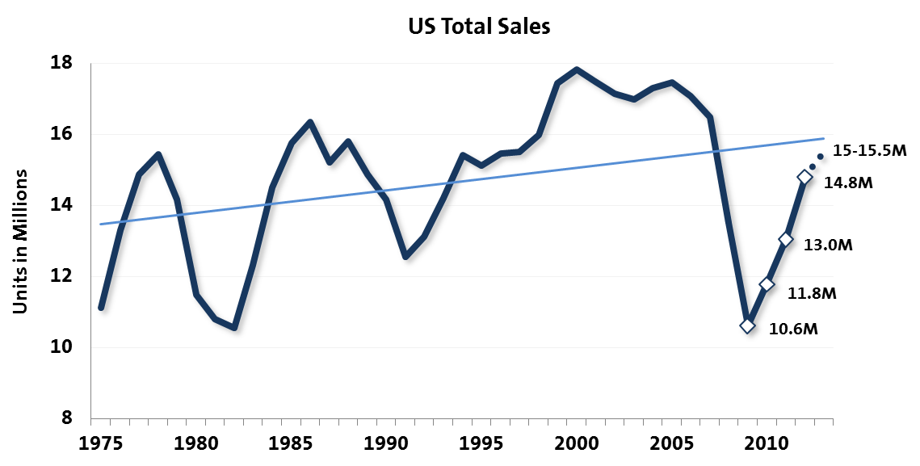
2013 Expectations
Demand for new automobiles accelerated in 2012 despite lethargic job and income growth, record high gasoline prices, and uncertainty stemming from the presidential election and debate in Washington over fiscal policy
Sales expanded 13% to 14.8M units in 2012, the largest one-year growth rate since 1984 and 4.2M units above the 2009 trough
Sales driven by pent-up demand, low interest rates, and improved credit flow
Total industry sales are forecast to grow at a decelerated rate to 15-15.5M units in 2013
Assuming a bearish outlook due to upcoming fiscal policy debate and uncertainty over the outcome

Slide 19

GREAT
CARS
TRUCKS
CROSSOVERS

